Slide 1
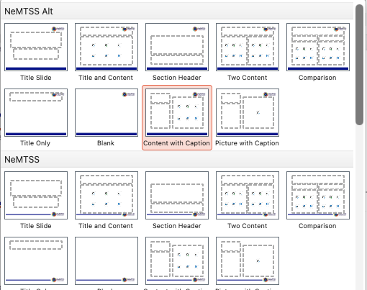
READ BEFORE USING TEMPLATE
This template contains several master slide options. To see all available slides, select the Layout dropdown. Make sure to scroll to the bottom to view all available slides.

Slide 2

ADA Checklist
Run accessibility check and resolve any issues before sharing presentation.
Important accessibility considerations (not a comprehensive list):
ONLY use master slides. Select from the NEW SLIDE dropdown. (Do NOT create a new slide using text boxes.)
Add alternative text to ALL images, including graphs and charts (Do NOT use SmartArt.)
Add captions to ALL images, graphs and charts.
All slides must include a title (if there are multiple slides with same title make sure to include “cont.” or indicate “part 1”, “part 2”, etc)
Keep bulleted lists to no more than two levels.
Text should be at least 20 pt size.
Only use NeMTSS grey, blue, purple and red for text on a white background; or use white text on full color backgrounds. (All NeMTSS colors are ok to use for icons/graphics/charts.)

Slide 3
Alt Text vs Captions
Alt Text
Captions
Alt text is not visible on the slide and enables screen readers to read out the description of the image for visually impaired users.
Should be as descriptive and literal as possible to accurately explain what the image is and what it is trying to convey.
Ask yourself: What does the image actually show?
Captions are visible and are intended to describe the image for all users.
Do not have to literally explain what the image shows and may provide additional context.
Should appear below the image.
Must be at least 20 pt. size for readability.

Slide 4
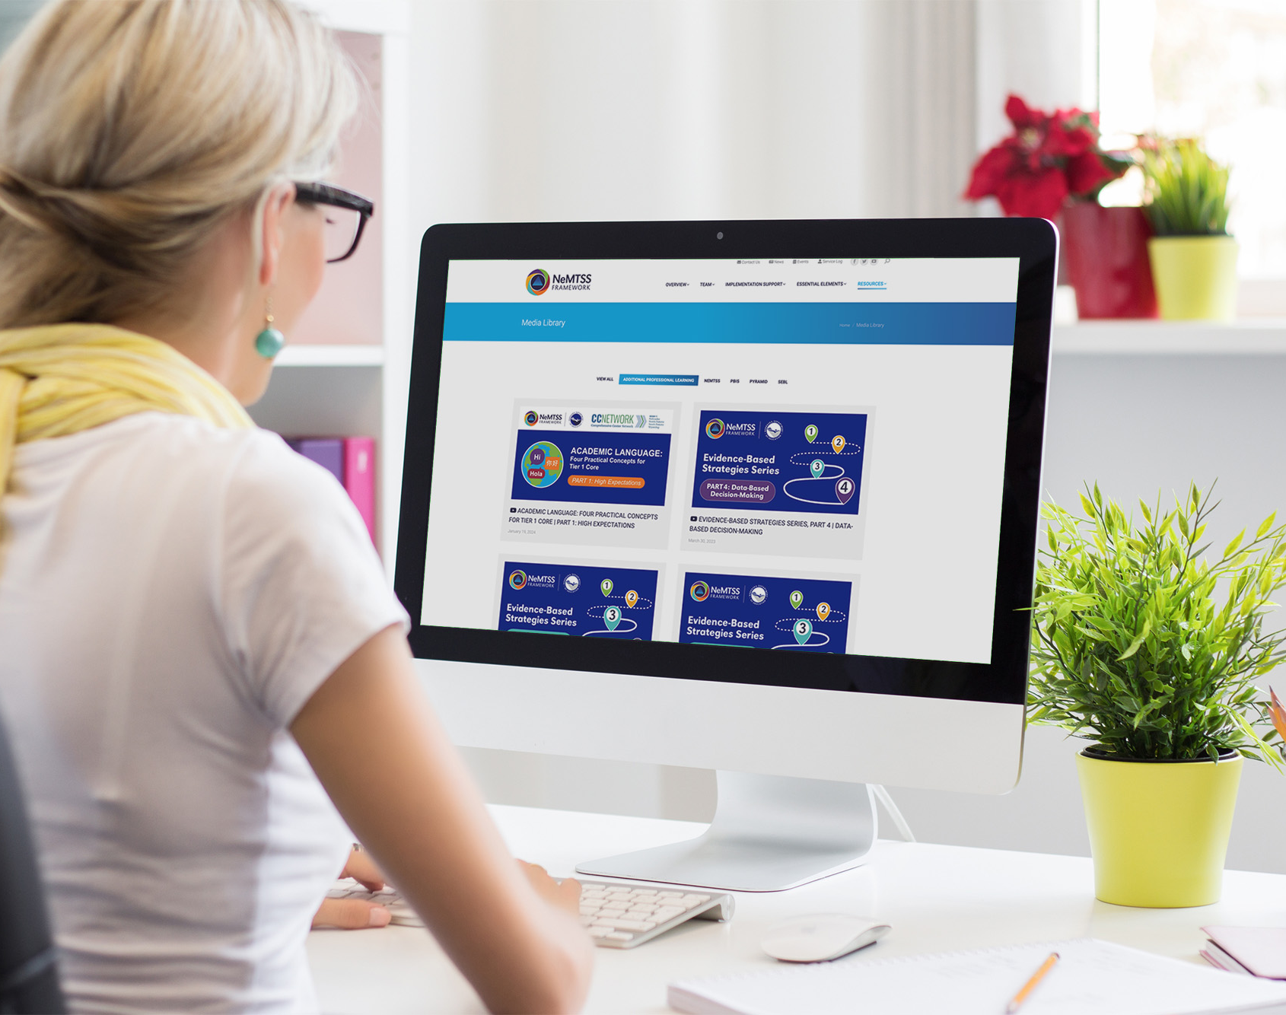
Alt Text vs Captions Example
Alt Text
Woman sitting at a desk in front of a computer.
Caption
The Nebraska MTSS website has additional professional learning opportunities are available to provide individualized implementation support.

